Slide 1
STATEWIDE WATER EDUCATION ACTION PLAN (SWEAP)
SOUTH PLATTE BASIN ROUNDTABLE
“Colorado’s first statewide education action plan designed to support the Water Plan’s goal of sustainable water by 2050.”
JAYLA POPPLETON
Executive Director, Water Education Colorado

Slide 2
TODAY’S OUTLINE
A brief overview of what this presentation will cover…
WHY SWEAP?
HOW DOES SWEAP WORK?
HOW CAN
I GET INVOLVED?
WHAT ARE THE NEXT STEPS?
We’ll discuss the need for SWEAP and how it was created.
There are many ways to participate based on your goals and resources.
Find out about the SWEAP timeline and how we’ll measure success.
Learn about the SWEAP framework and benefits to local educators and communities.

Slide 3
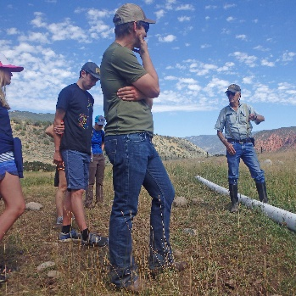
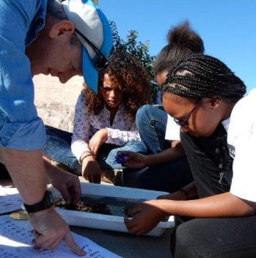
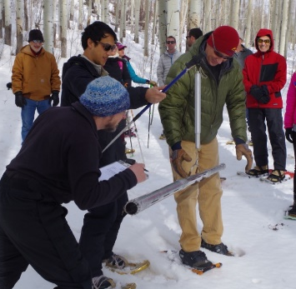
WHY SWEAP?
The Colorado Water Plan predicts a water supply shortfall of more than 500,000 acre-feet by 2050.
Colorado Water Plan
Chapter 9.5: Outreach, Education and Public Engagement
“To expand outreach and education efforts that engage the public to promote well-informed community discourse and decision making regarding balanced water solutions.”
Empower Coloradans to take an active role in their communities and make informed decisions about critical water issues.

Slide 4
PEOPLE & PROCESS
How SWEAP was created…
01
FUNDING
02
CONSERVATION IMPACT
Colorado Water Plan Engagement & Innovation Grant
ThinkWater by USDA
Collaborative process
Situational analysis
Stakeholder interviews
04
03
STRATEGIC PLANNING
THE COALITION
PEPO
NGOs
Government
Universities
Water Educator Network
Vision/Impact
Outcomes/Goals
Strategies
Actions

Slide 5
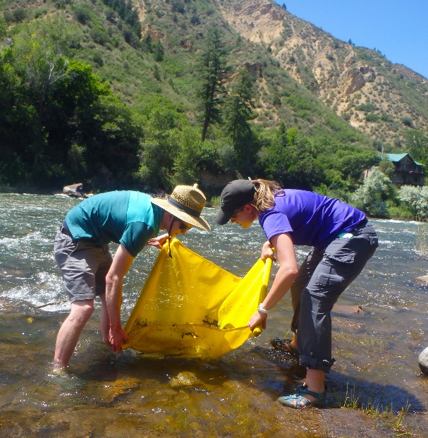
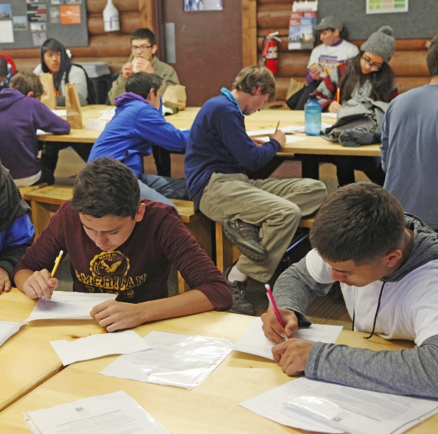
HOW DOES SWEAP WORK?
First-of-its-kind
5-year plan
CO-specific
SWEAP Vision
Coordinated, well-funded, and impactful education, outreach, and public engagement achieving measurable objectives in water education by 2025 that contribute to sustainable water by 2050.
“
SWEAP Impact
SWEAP strengthens local and regional water education activities through a shared vision that will advance Colorado’s Water Plan.
By 2025, Coloradans are engaged in well-informed community discourse and decision-making regarding balanced water solutions, and are empowered to take thoughtful action regarding critical water challenges facing the state and their communities.
“

Slide 6
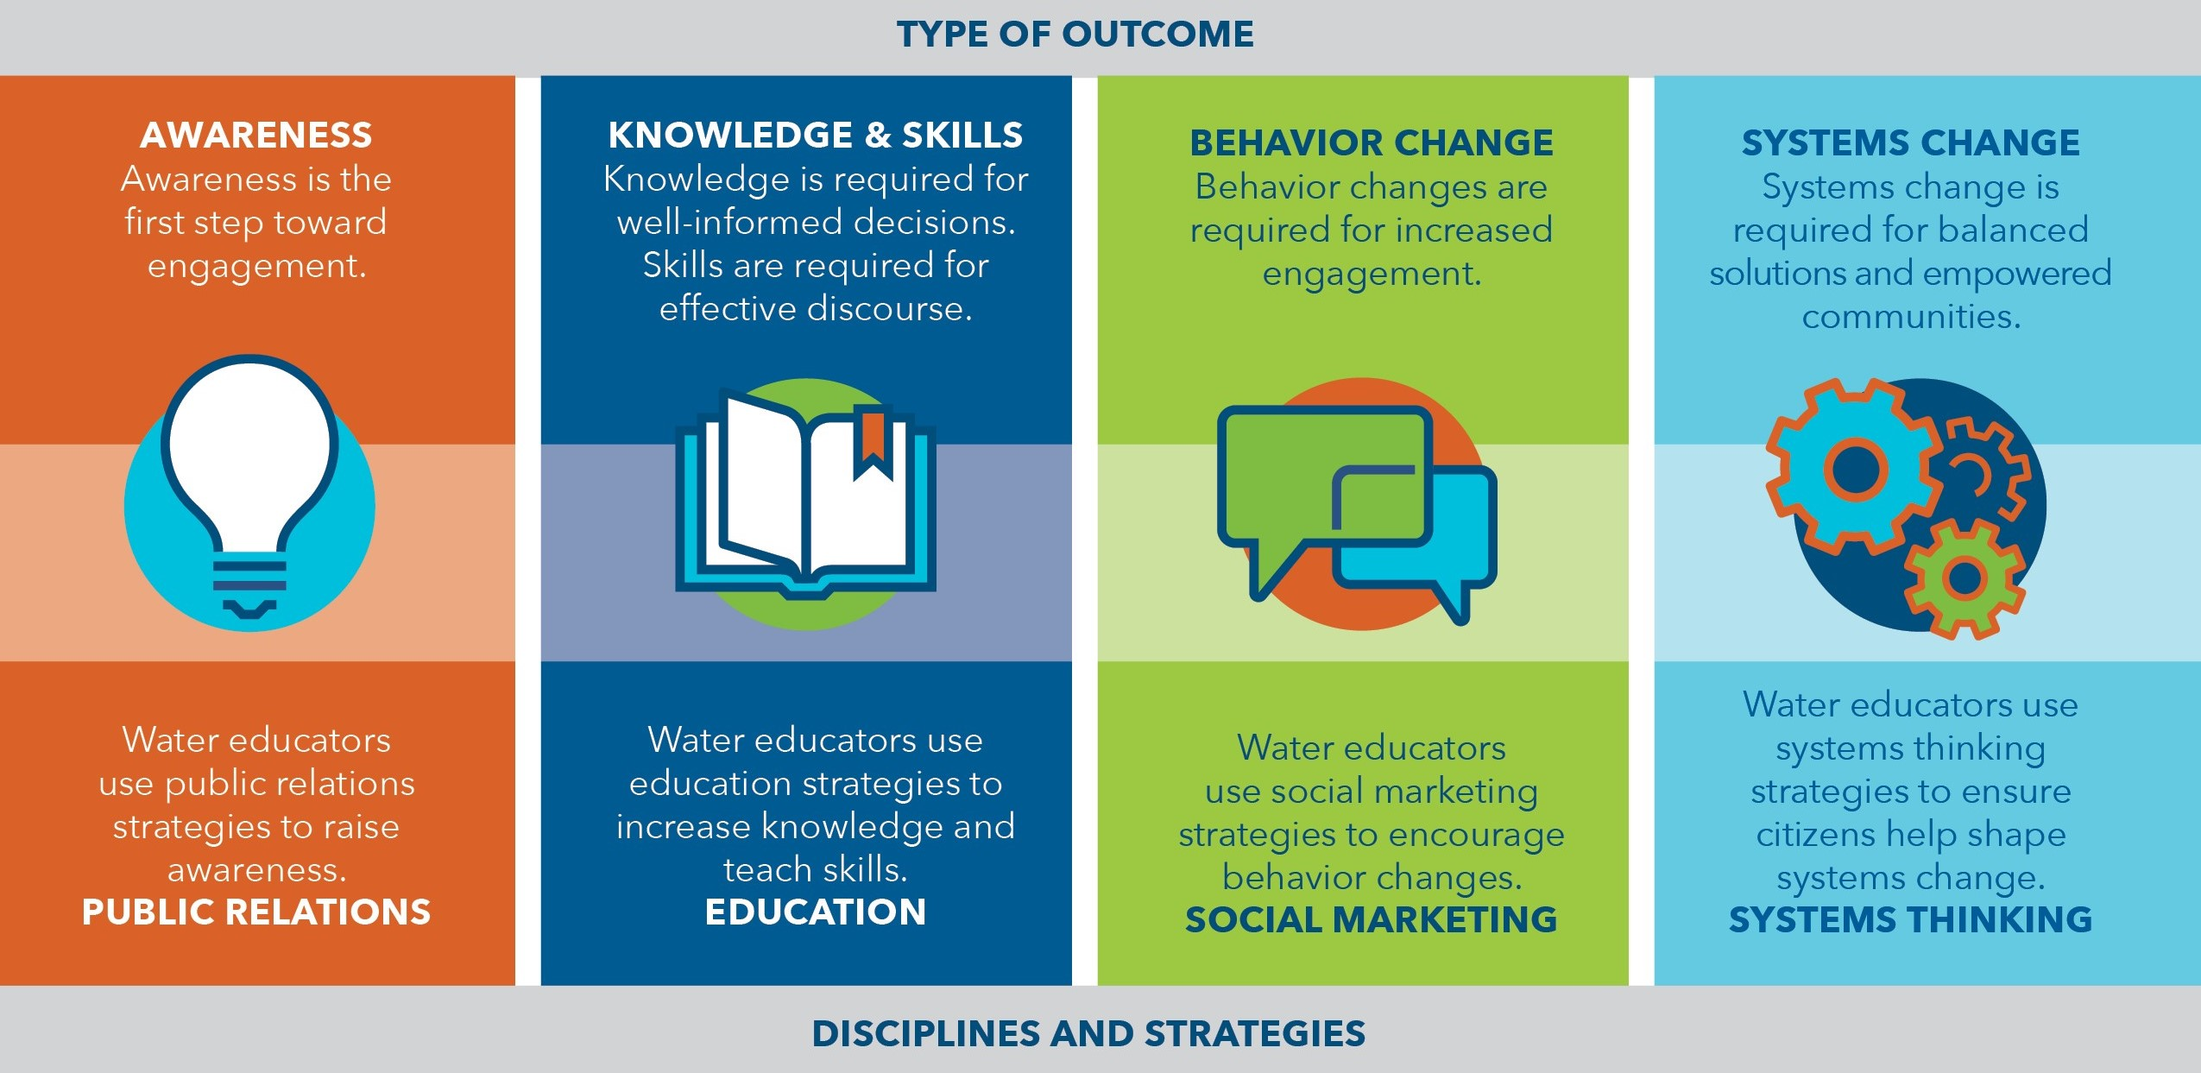
EDUCATION CONTINUUM
Types of SWEAP outcomes and related disciplines…

Slide 7
SWEAP FRAMEWORK
The strategic framework is the backbone of SWEAP…
“With a shared vision, guiding principles, and a core set of shared outcomes, individual actions will achieve the greatest possible impact – both locally and statewide.”

Slide 8
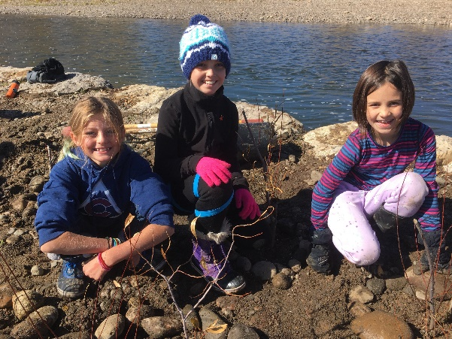
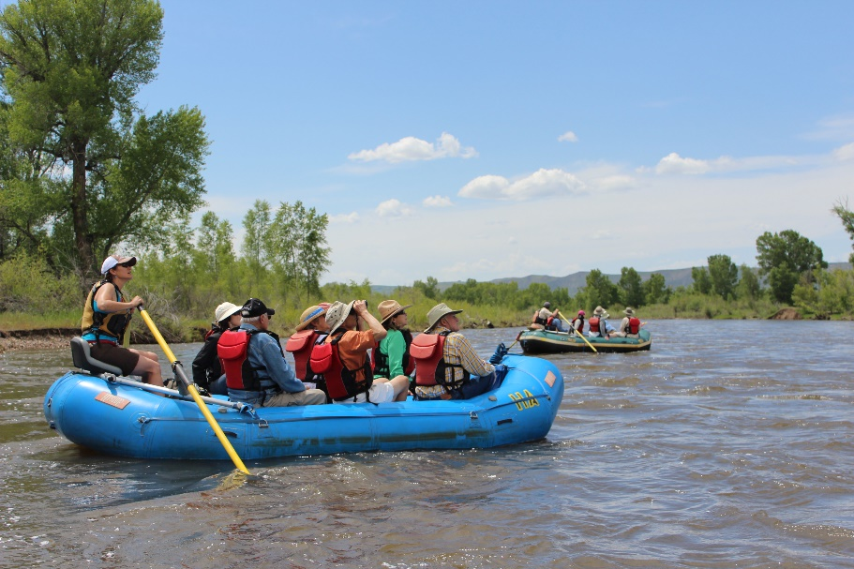
SAMPLE OUTCOMES
Some examples of the 10 SWEAP outcomes…
1
AWARENESS
The proportion of Coloradans (in each river basin) who can identify how water supports their quality of life, as well as the threats to and potential solutions for a sustainable water supply, increases.
2
KNOWLEDGE & SKILLS
The proportion of Coloradans (in each river basin) who can articulate at least three “critical water concepts,” increases.
3
BEHAVIOR CHANGE
Participation in community discourse and decision processes about water at the state, regional and local levels increases.
4
SYSTEMS CHANGE
Where relevant, local and state policies and practices are supportive of advancing statewide water literacy.

Slide 9
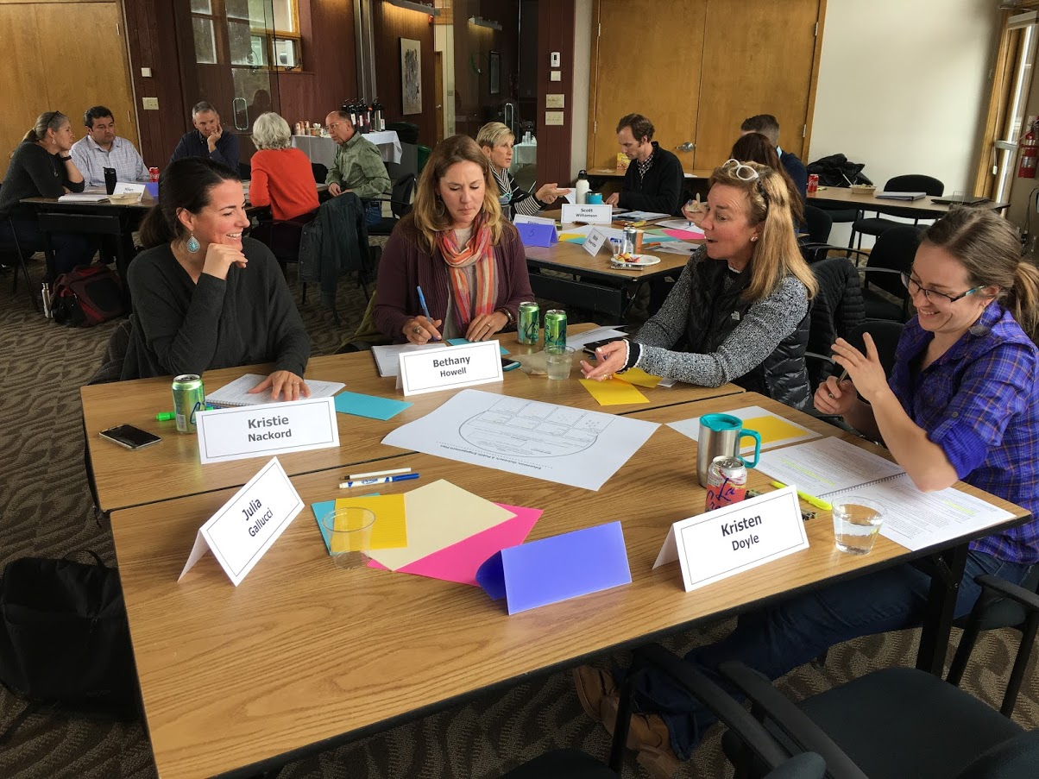
HOW CAN I GET INVOLVED?
Organizations and individual educators will develop actions to meet the unique needs and interests of their communities, while also contributing to the shared outcomes identified in SWEAP.
No one is expected to address every outcome or embrace every strategy.
SWEAP bridges water education gaps across the state by supporting and expanding educator reach.

Slide 10
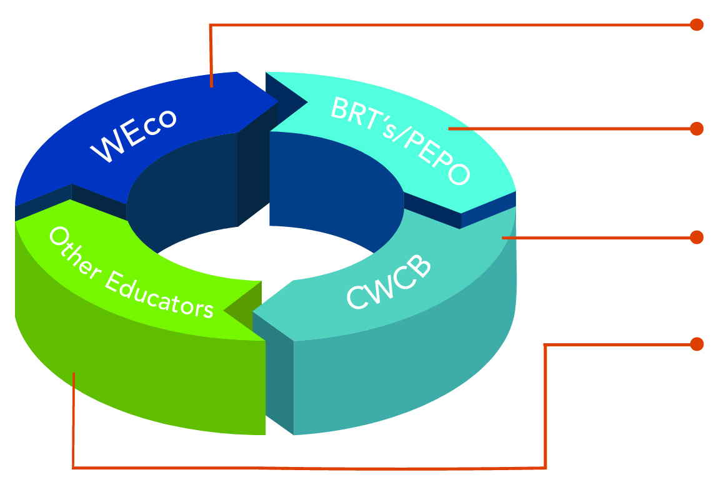
UTILIZING SWEAP
What each group can do to participate…
Guide a focused statewide strategy; offer resources and support
Education Action Plans and BIP updates
Colorado Water Plan updates
Identify alignment, contribute to state strategy, amplify efforts, share resources

Slide 11
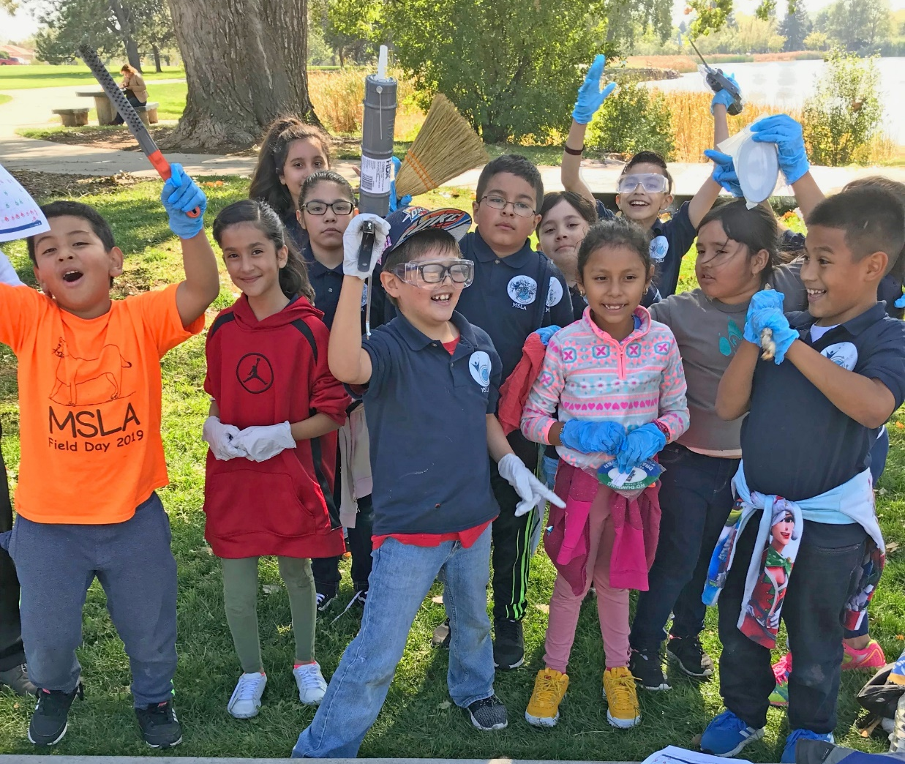
WHAT ARE THE NEXT STEPS?
SWEAP Timeline
Nov. 2019: Final CWCB Presentation
Jan-Mar 2020: Launch SWEAP
Apr-Jun 2020: On-boarding; Baselines
Jul-Dec 2020: Develop resources

Slide 12
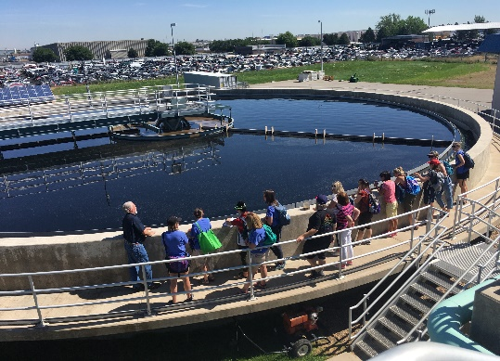
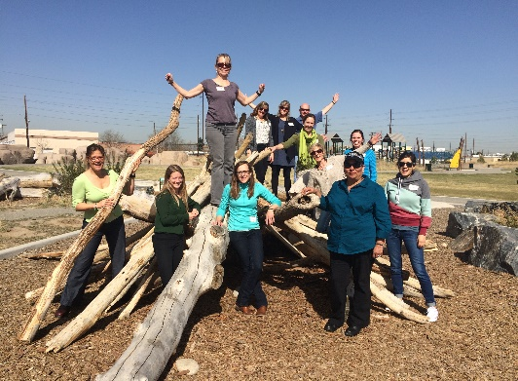
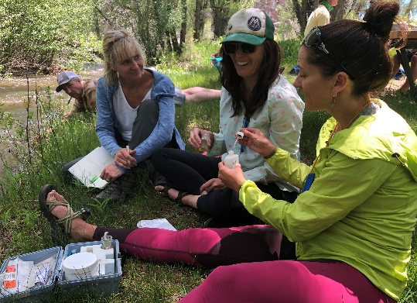
MEASURING SUCCESS
Here’s what you can do to help move the needle…
Learn
Support
Participate
Visit the SWEAP website: www.wateredco.org/sweap. Download the SWEAP Executive Summary or read the Full Plan.
Please consider submitting an endorsement on behalf of your organization to demonstrate your commitment to SWEAP.
We invite you to start implementing SWEAP right now! Let us know what you’re doing so we can track efforts statewide.

Slide 13
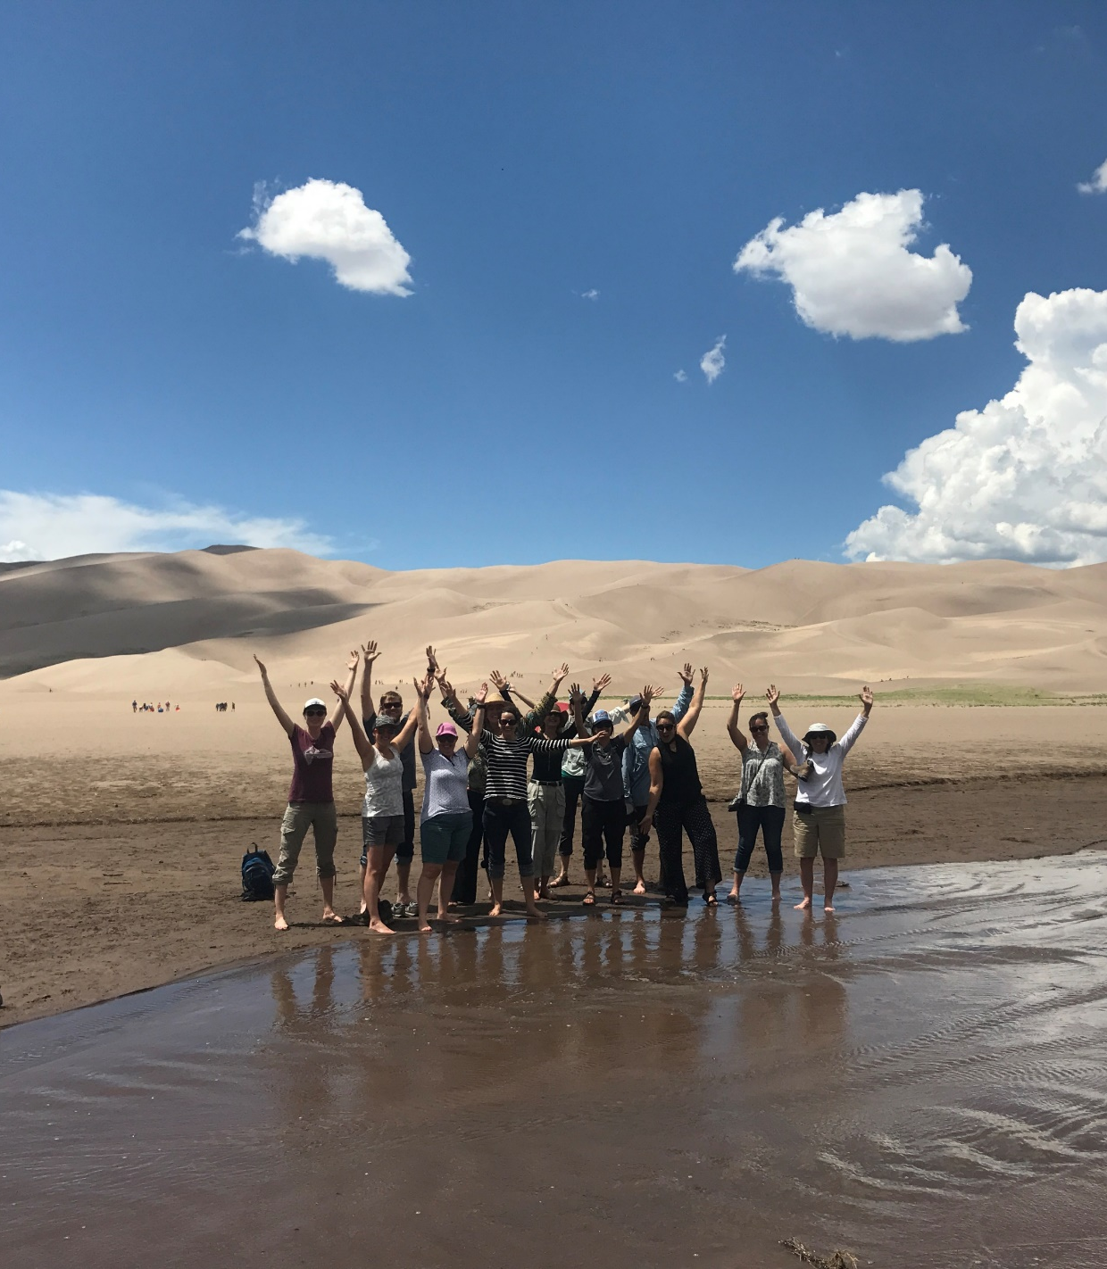
Let’s work together on this!
Jayla Poppleton, WEco E.D.
Jayla@wateredco.org I 720-325-1448
Scott Williamson, WEco Ed/Outreach Coord.
Scott@wateredco.org I 303-377-4433
Rob Buirgy, SWEAP Coordinator
Rob@wateredco.org I 970-690-4655
Presentation created by:

